Slide 1

Enhanced Peri-Operative Care
for High-risk patients
Introductory slide-set
Notes:
1
1
1

Slide 2
234 million major surgical procedures worldwide
True mortality rate is not known
A preventable death rate of 1% would result in... ...2.3 million avoidable deaths each year
Notes:
2
2

Slide 3


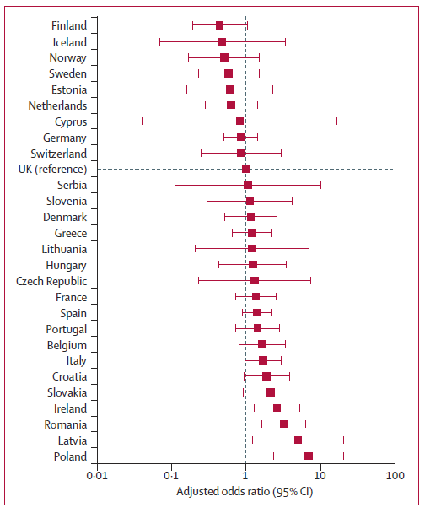

Slide 4
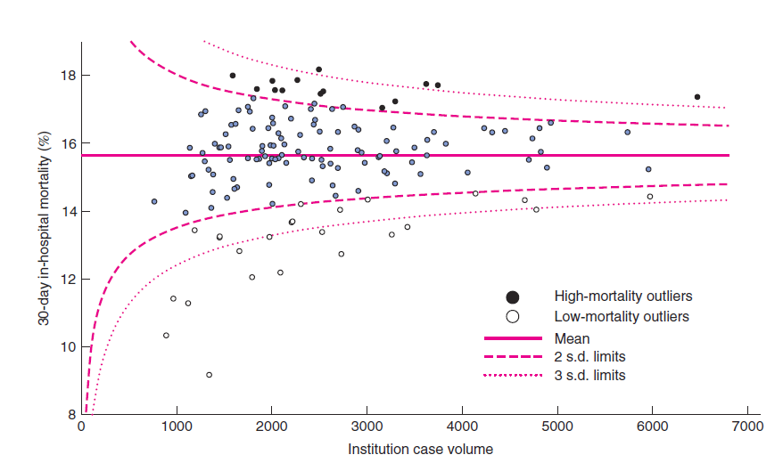
Variation in mortality after emergency surgery in the UK
Symons N et al. Brit J Surg 2013; 100: 1318-25.

Slide 5
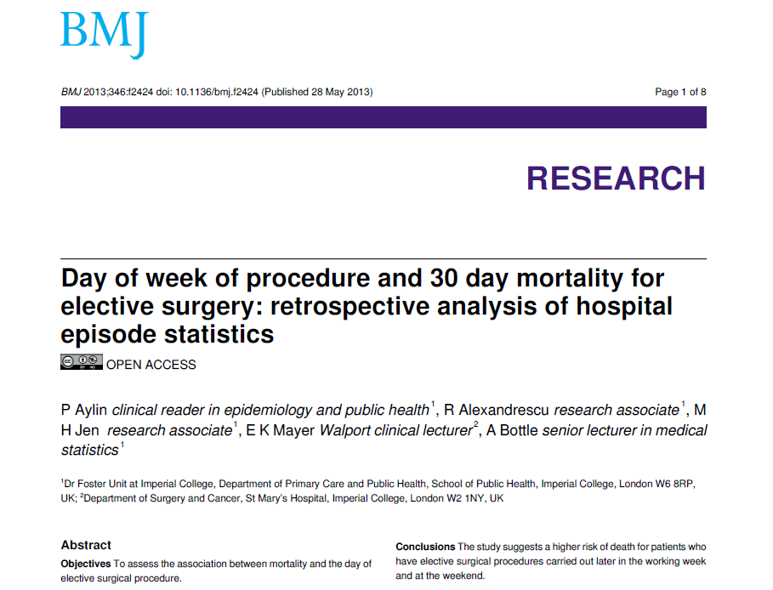
More patients die following surgery on a Friday…

Slide 6
Background
80% of surgical deaths in high-risk group
Emergency laparotomy is a typical case
Patient care is highly variable
Survival is highly variable
Quality improvement may improve outcome

Slide 7

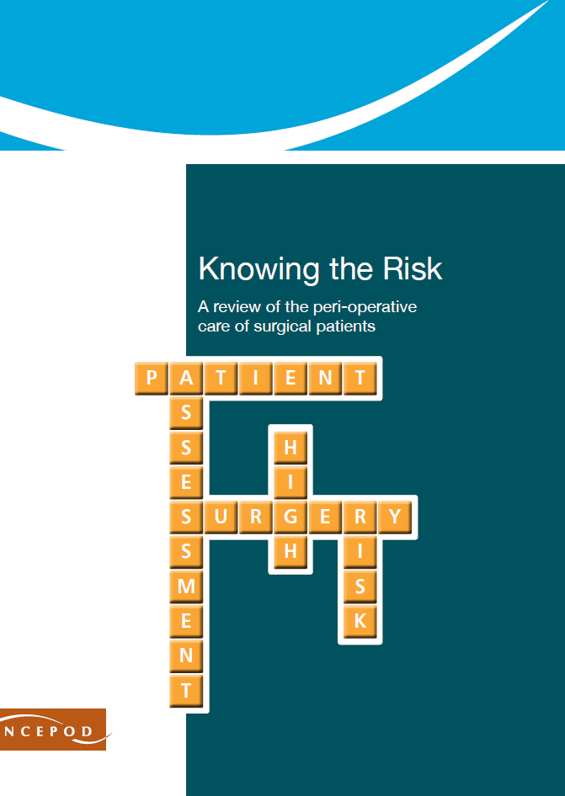
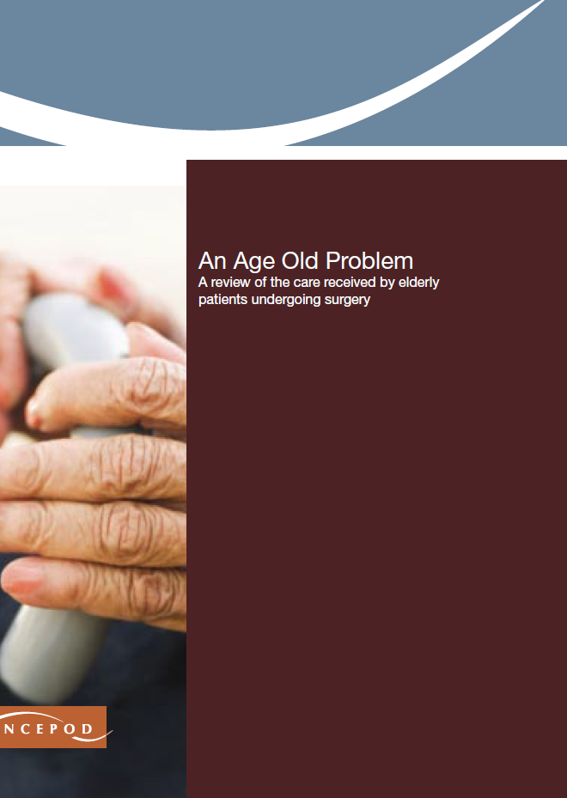

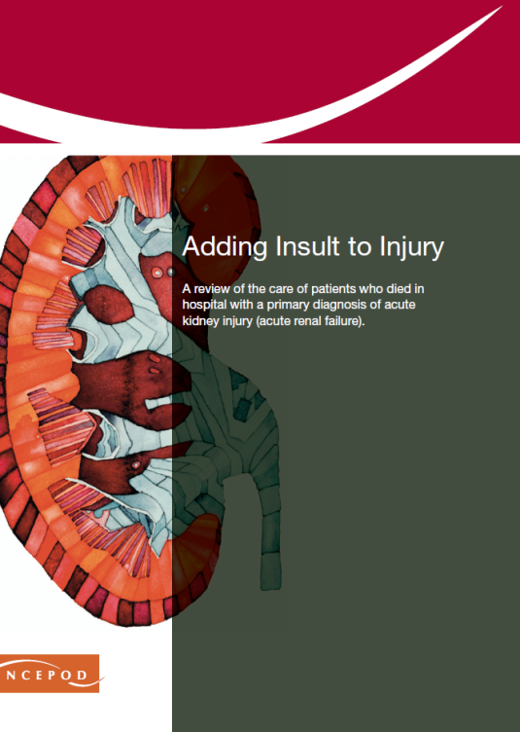



1987

Slide 8
Objectives
Can a quality improvement project to implement a care pathway improve 90 day survival for emergency laparotomy?
  Integrated ethnographic evaluation
  Cost-effectiveness of project
  Long-term impact on mortality (via HQIP-NELA)

Slide 9
Pilot data
Emergency Laparotomy Network & HES data
Wide variations in standards of care
30 day mortality varies widely (4 to 31%)
25% mortality at 90 days
Saunders et al. Brit J Anaesth 2012;109: 368-75.

Slide 10

Trial design
Stepped wedge randomised cluster trial
  Hospitals randomised in geographical clusters
  Integrated ethnographic & economics analyses
  Data capture via HQIP-NELA
Intervention
  Integrated Care Pathway
  Local leadership by ‘champions’
  QI training, cluster meetings, web-based resources

Slide 11
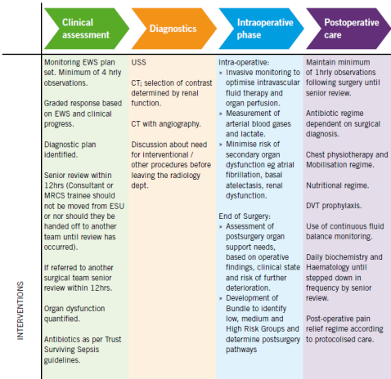
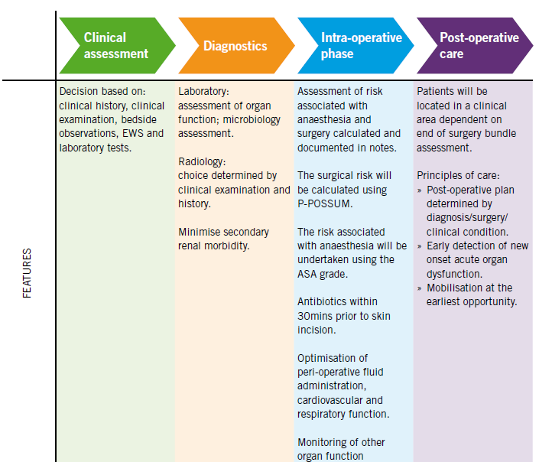
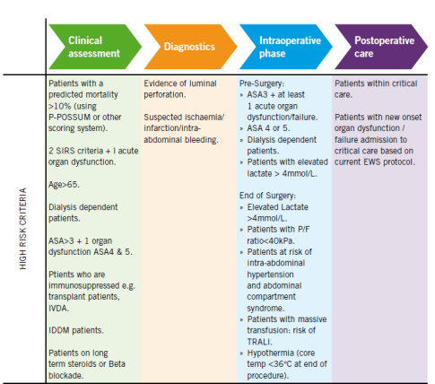
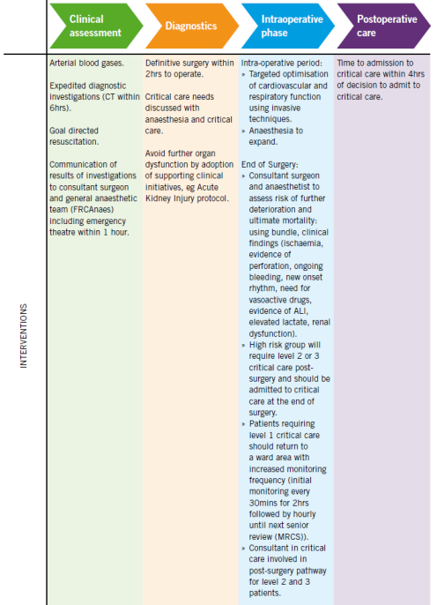
Integrated Care Pathway adapted from:
Higher Risk Surgical Patient; RCS 2011

Slide 12
Patients
Aged ≥40 years undergoing non-elective open abdominal surgery in acute NHS hospitals
Exclusions: Gynaecological and trauma laparotomy, Repeat laparotomy, Appendicectomy

Slide 13
Outcome measures
Primary: 90 day mortality
Secondary:
  Hospital stay
  Hospital re-admission
  180 day mortality
  Cost effectiveness

Slide 14
Sample size
Recruited 98 NHS hospitals in 15 regional clusters
27,540 patients
90% power for mortality reduction from 25 to 22%
Fixed 85 week intervention period
Potential to recruit every eligible patient

Slide 15
Project team
Pragmatic CTU, QMUL
Quality improvement team led by Carol Peden
Ethnography expertise from Leicester
Methodology expertise from Birmingham
EPOCH pathfinder hospitals
Advisory group representing all stakeholders

Slide 16
Trial timelines
Winter 2013/14
  Start-up
March 2014
  Trial starts (data collection via NELA)
April 2014
  First cluster ‘activated’ to QI intervention
August 2015
  Final cluster activated
Mid - Sept 2015
  Final patient recruited
Cluster randomisation diagram

Slide 17
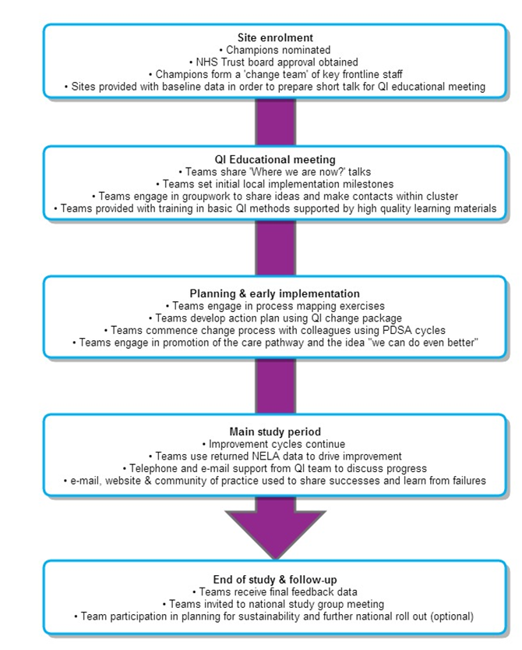
QI intervention: site timeline

Slide 18
?
EPOCH Contacts
Trial Queries kirsty.everingham@bartshealth.nhs.uk 0203 594 0352 Quality Improvement Queries qi@epochtrial.org 0203 594 0352
Notes:
18

